Slide 1



Books Orders Dashboard
View in Power BI
Last data refresh:
9/16/2025 6:46:49 PM UTC
Downloaded at:
9/19/2025 5:59:39 AM UTC

Slide 2
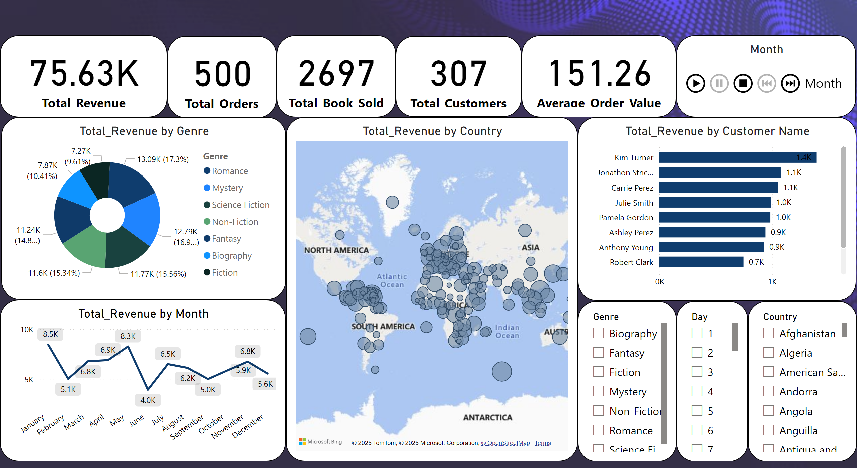
Page 1
Notes:
slicer
No alt text provided
PBI_CV_16948668_E17D_454B_8664_2F2C470EA8C1
No alt text provided
slicer
No alt text provided
slicer
No alt text provided
card
No alt text provided
map
No alt text provided
barChart
No alt text provided
donutChart
No alt text provided
lineChart
No alt text provided
card
No alt text provided
card
No alt text provided
card
No alt text provided
card
No alt text provided

